Slide 1


SmartCalc Pro Multi-Purpose Calculator Application
Developd By:
SAAYAN SAMANTA

Slide 2
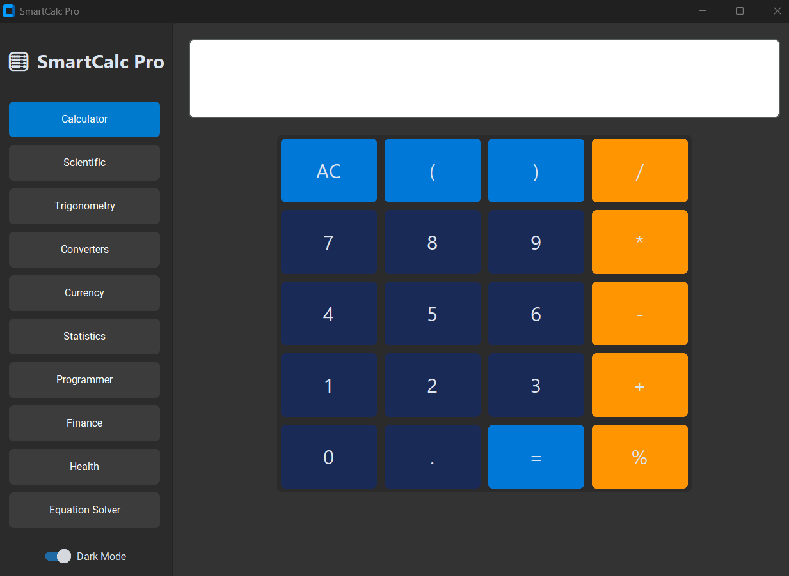
About SmartCalc PRo
SmartCalc Pro is an all-in-one calculator application designed to provide multiple calculation utilities within a single platform.
The application combines scientific, financial, statistical, health, equation-solving, currency conversion, and unit conversion functionalities in an intuitive graphical interface.

Slide 3
Key Functionalities
Traditional Calculator | SmartCalc Pro
Basic Calculations Only | Multiple Calculators in One App
No Equation Solving | Advanced Equation Solver
No Statistics | Complete Statistical Analysis
No Finance Tools | EMI Calculator
No Health Tools | BMI Calculator
Limited Conversions | Unit & Currency Conversion
Basic UI | Modern CustomTkinter UI
Technology | Purpose
Python | Core Programming Language
CustomTkinter | Modern GUI Development
SymPy | Equation Solving
Statistics Module | Statistical Analysis
Requests | Currency Exchange API
Math Module | Scientific Calculations
JSON | API Data Processing

Slide 4

Challenges Faced
1)
Problem: Different calculators required different layouts.
Solution: Created independent CustomTkinter Frames for each tab.
Problem: Handling user input and data validation.
Solution: Implemented exception handling and dynamic data storage.
Problem: Need for live exchange rates.
Solution: Integrated Exchange Rate API and JSON data parsing
2)
3)

Slide 5

References
Documentations :
Python Official Documentation
CustomTkinter Documentation
SymPy Documentation
APIs :
Exchange Rate API
Learning Resources :
W3Schools Python Tutorial
GeeksforGeeks Python Tutorials

Slide 6


